Slide 1
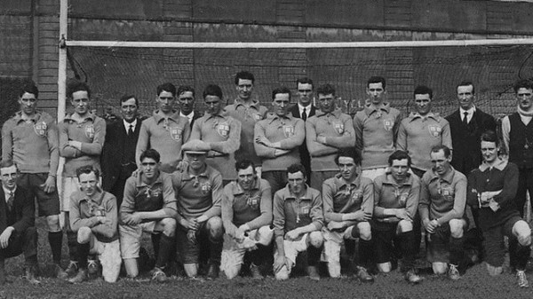
Bloody Sunday
By Niamh , Ava & Naomi

Slide 2
About Bloody Sunday
Bloody Sunday Occurred on Sunday the 21st of November 1920, it happened during the Irish war of independence while Dublin were playing Tipperary at Croke Park. It was a tragic day as 14 people died and more than 30 people were injured.

Slide 3
During Bloody Sunday
On the morning of November 21st 1920 an elite association known as the elite squad mounted on operation planed by Michael Collins, Director of Intelligence of the Irish republic army (IRA). Their orders were clear, they were to take out the backbone of the British intelligence network in Ireland specifically a group of officers known as the Cairo gang.

Slide 4
What happened
During The first few minutes of the match the British army had soldiers blocking the exits letting no one out. When the shooting began everybody tried to escape, People thought about Getting themselves out but one man, named Patrick O'Dowd was brave enough to help people over the wall instead of thinking about himself, he kept helping people until he was shot in the head and died.

Slide 5
Michael Hogan
Michael Hogan from Grangemockler was the only player to be killed on Bloody Sunday. He was the corner back on the Tipperary team and came from a farming background. Hogan was marking Dublin’s star forward Frank Burke of VCD on the day. He was shot in the back as he crawled along the pitch to escape the shooting. In the aftermath Hogan’s teammate Ned O’Shea identified his body. In 1925 the GAA named a stand in Croke Park the Hogan stand in honour of Michael Hogan.

Slide 6
Jane Boyle
Jane Boyle was a shop assistant working at Spiedel’s butchers on Talbot street in Dublin. Jane was one of the civilian casualties of Bloody Sunday. She was the daughter of Thomas and Jane Boyle. Jane had attended the match with her fiancé Daniel Byron, they were due to married on the following Friday. She never got to marry because she was shot and died in her fiancé’s arms. She was later buried in her wedding dress. On her headstone it notes that she was living at 12 Lennox street, Portobello with her sister Mary.

Slide 7
Thomas Hogan
Thomas Hogan was 19 years old, he was the youngest of seven children born to Patrick and Elizabeth Hogan in Tankardstown, Kilmallock county Limerick. Before he was eleven years old, Tom had lost both his parents and his eldest sister Katie, the only member in the family to have a child. Toms other sister Maggie left her job to come take care of the family. Tom joined the volunteers and moved to Dublin where he lived at St James’. On Bloody Sunday Tom was shot in the shoulder and was admitted to Manor hospital in a critical condition. His right arm was amputated and he later died from serious injuries.

Slide 8
The result
Bloody Sunday was a tragic but memorable day for Ireland. It resulted in 14 people dying and more than 30 badly wounded. After the assassination many Irish people turned against the British government and joined forces with the IRA. This year marked the 100th anniversary of Bloody Sunday in 1920.

Slide 9
QUIZ TIME!!!
What teams where playing during bloody Sunday?
Dublin & Tipperary
What stand was named after one of the victims?
The Hogan stand

Slide 10
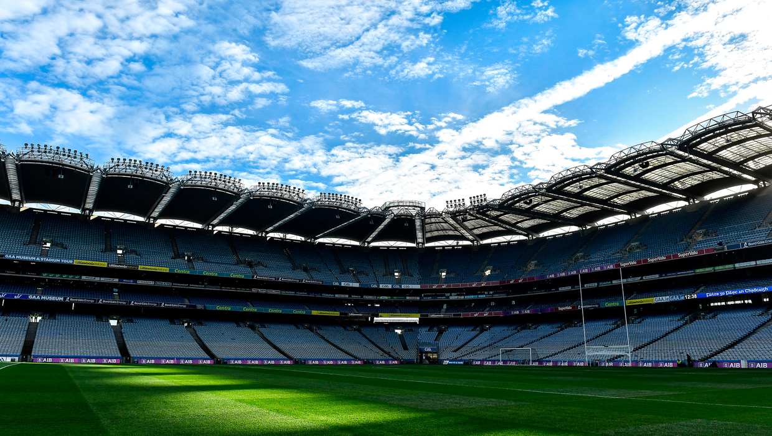
An deireadh

